Slide 1
Nuclear in My Back Yard Grant Program Pilot Briefing Slides Rev 2 11-10-18 vg

Slide 2
Vince Gilbert
OPD Past Chair
http://opd.ans.org/nimby/
(202) 422 8238 cell
11/10/18

Slide 3
Program Description-What
ANS’s Operations and Power Division (OPD) offers all ANS members the opportunity to apply for funds to support a new ANS product, program or other activity that will help the Society achieve the following:
1. Develop the professional skills and knowledge of ANS members
2. Advance nuclear science & technology through collaboration and outreach
3. Meet the needs of ANS utility and supplier members
4. Engage the public
5. Engage policymakers
Members are encouraged to be creative, think outside the box, and to not restrict ideas to a dollar amount. All ideas will be considered. While this is a pilot grant program for 2017-2018, your participation, activities and enthusiasm will help in allocating funds for future years.

Slide 4
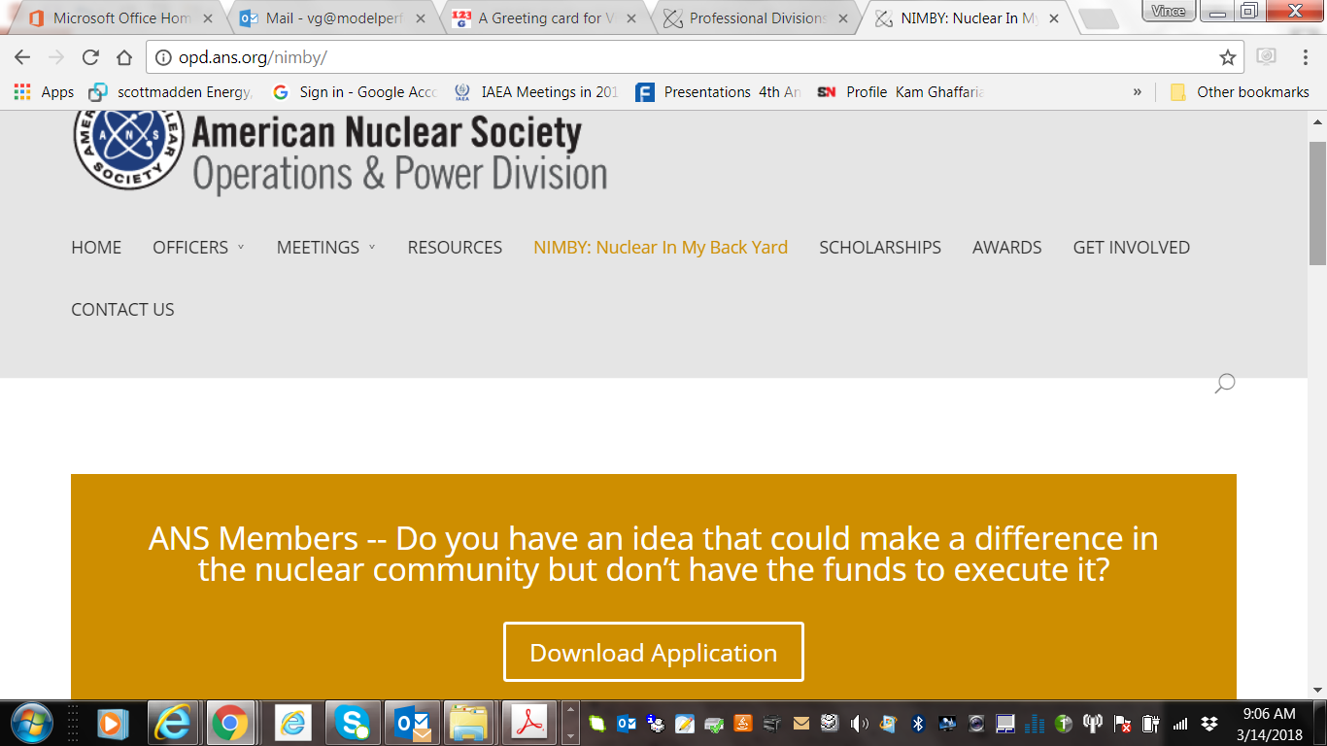
Where
Attached is a description of the funding program and an application form. These documents are also posted on the OPD website. If several applications are received in the same timeframe there may be a waiting list for funds to become available.

Slide 5
PROGRAM PARAMETERS and DISCLAIMERS
This is a pilot program that may be changed or withdrawn at a later date.
The processing time for review and action of each proposal may vary but it is expected to be one to two months.
Reviews will be conducted as proposals are received and awards will be based on merit
Review results may include return of the proposal with questions, approval or disapproval. The implementation of awards must be conducted through an ANS Local Chapter. Implementation time may vary but could be about one to two years.
The proposed program or product does not have to fall within the scope of the OPD. The OPD Executive Committee is taking a “One ANS” approach to these funds.
The only OPD expectation is that projects result in new programs or products which help ANS achieve financial stability and/or an increased non-monetary value to membership aligned with the strategic plan.
While it is possible that OPD may be able to continue funding the creation of new programs and products for the society in future years, there is currently no commitment to do so, which is why the funding provision is currently a one-time allocation of OPD funds.
Successful execution of these initial seed projects will determine the level of priority the OPD Executive Committee will place on future allocations.
This program is not generally for Research and Development activities.
Funds should be expended in the United States and under the coordination auspices of an ANS Local Section or ANS HQ staff familiar with the subject matter.

Slide 6
Funding Limitations
No specific funding request limit has been set
However the Pilot Program total funding has been budgeted to $50,000 (2018) and $65,000 (2019)
Each Project Funding is expected to be used within two years.
A typical funding level might be $5,000-$10,000.
Matching funds from other sources are encouraged

Slide 7
How: The Process
OPD EC Review
Approve, Disapprove, Return for Questions
Apply
Re-Application Option
Assign OPD PM and ANS Local Section Coordinator. & allocate funds
Write OPD Disbursing Form
OPD Tabulate and Communicate Results
Complete Feedback Report
Implement the grant activities

Slide 8
Accountability
OPD Executive Committee will review proposals and authorize grants and issue a project number. OPD EC will assign a Project Manager.
The funding sponsor (ANS Local Section) will assign a Coordinator or if there is no local section, ANS HQ may provide the PM.
Funds are made available by the OPD Treasurer and Chair via one or more Disbursing Forms.
The Grant Recipient will provide a feedback report when the grant is completed or end of year.
The application Form contains all the accountability documentation details and signatures required.

Slide 9
Feedback
The feedback (“Outreach Event Report”) is due back to OPD 30 days from the completion of the awarded project or if the funds have been fully expended. The report format is an ANS Outreach Event Report Form
The report is to document results achieved as compared to problem statement and results expected when funds were requested.

Slide 10
Legacy Projects
Three Projects were conducted by the ANS Nuclear Committee in the States in 2017-2018
Virginia
Michigan/Ohio
Washington

Slide 11
Number | Recipient | Date | Amount | Project Scope
2017-01 | VA |  | $ 2,000 | 6-Month Outreach Plan Jan-Jun 2018 sponsored by ANS VA Local Section and VCU
2017-02In Progress | MI/OH |  | $ 4,000 | ANS-member supported activities advocating new State legislation leading to continued operation of Ohio's nuclear plants operated by First Energy
2017-03 | WA |  | $ 2,000 | Hold a Grass Roots Public Outreach Event in Seattle Washington
In Progress
Complete
Complete

Slide 12
Since March 2018 Ten NIMBY Proposals were submitted to OPD
In Batch One two were approved in April and two were returned with comments
In Batch Two three were approved in June and three were returned with comments.
Total Committed 2018 funds is $30,090.
Estimated remaining 2018 funding is about $18,910 and 2019 funding is budgeted at $ 65,000.

Slide 13
NIMBY Number | Requester | Date | Amount | Project Scope/Amount Approved/Date | Review Results | 2018 Approved (Budget $50,000) | 2019 (Forecast) (Budget $65,000)
2018-01 | ANS Washington, DC Office | 2/22/2018 | $ 24,000 | ANS Grassroots Advocacy Tool 4/26/18 | Approved | $ 12,000 | $ 8,000
2018-02 | Idaho Local Section | 3/8/2018 | $ 5,000 | STEM Outreach - Western States 4/26/18 | Approved | $ 2,500
2018-03 | Colrado Local Section | 3/19/2018 | $ 200,000 | Reducing Operating Costs at Nuclear Power Plants | (Returned with comments) | $ -
2018-04 | Idaho Local Section | 3/20/2018 | $ 100,000 | Disposal of spent nuclear fuel and high-level radioactive waste | (Returned with comments) | $ -
2018-05 | Las Vegas Local Section | 4/16/2018 | $ 10,900 | Workshops for Boy Scouts Nuclear Science Merit Badge and Girl Scouts Know Nuclear Badge | Approved | $ 3,200
2018-06 | Las Vegas Local Section | 4/16/2018 | $11,900 | Support Yucca Mountain and Benefits to Nevada | Approved | $ 6,000
2018-07 | Nuclear Innovation Bootcamp | 3/30/2018 | $5,000 | Nuclear Innovation Bootcamp | Returned with comments
2018-08 | Generation Atomic | 5/31/2018 | $5,000 | Generic Nuclear Advocay Event | Returned with comments
2018-09 | Generation Atomic | 5/31/2018 | $6,390 | ANS profiles and Meeting Documentary | Aproved (for ANS Winter Meting in partnership with ANS HQ) | $ 6,390
2018-10 | Generation Atomic | 5/31/2018 | $6,000 | Advocay Technology Upgrades | Returned with comments
 |  |  |  |  |  | $ 30,090 | $ 8,000

Slide 14
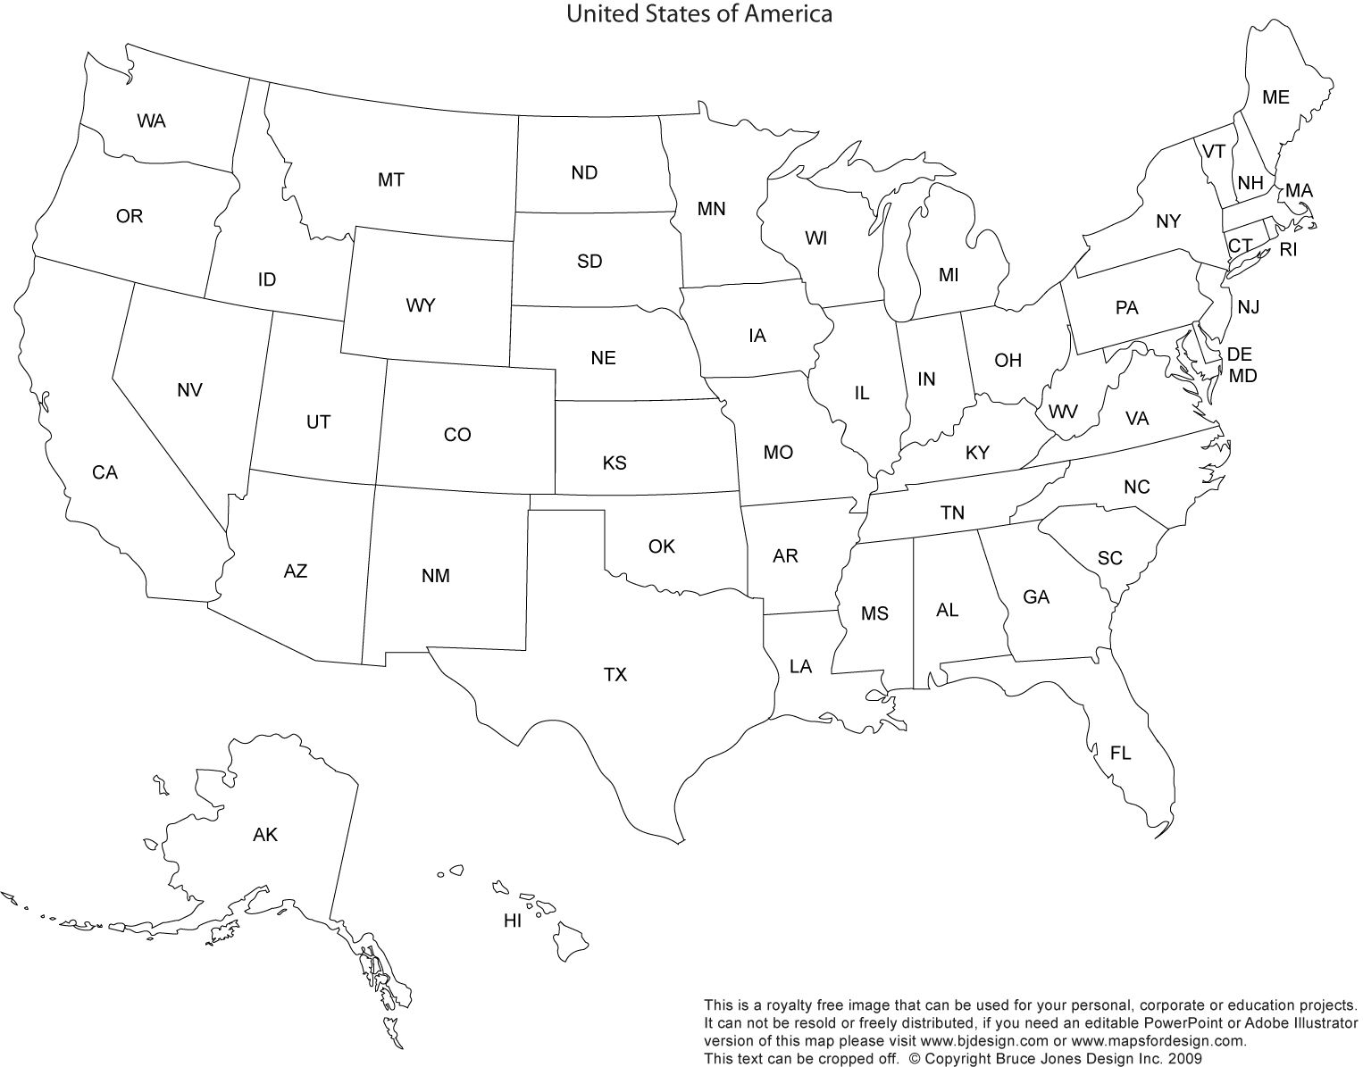
NIMBY Funding Locations

Slide 15
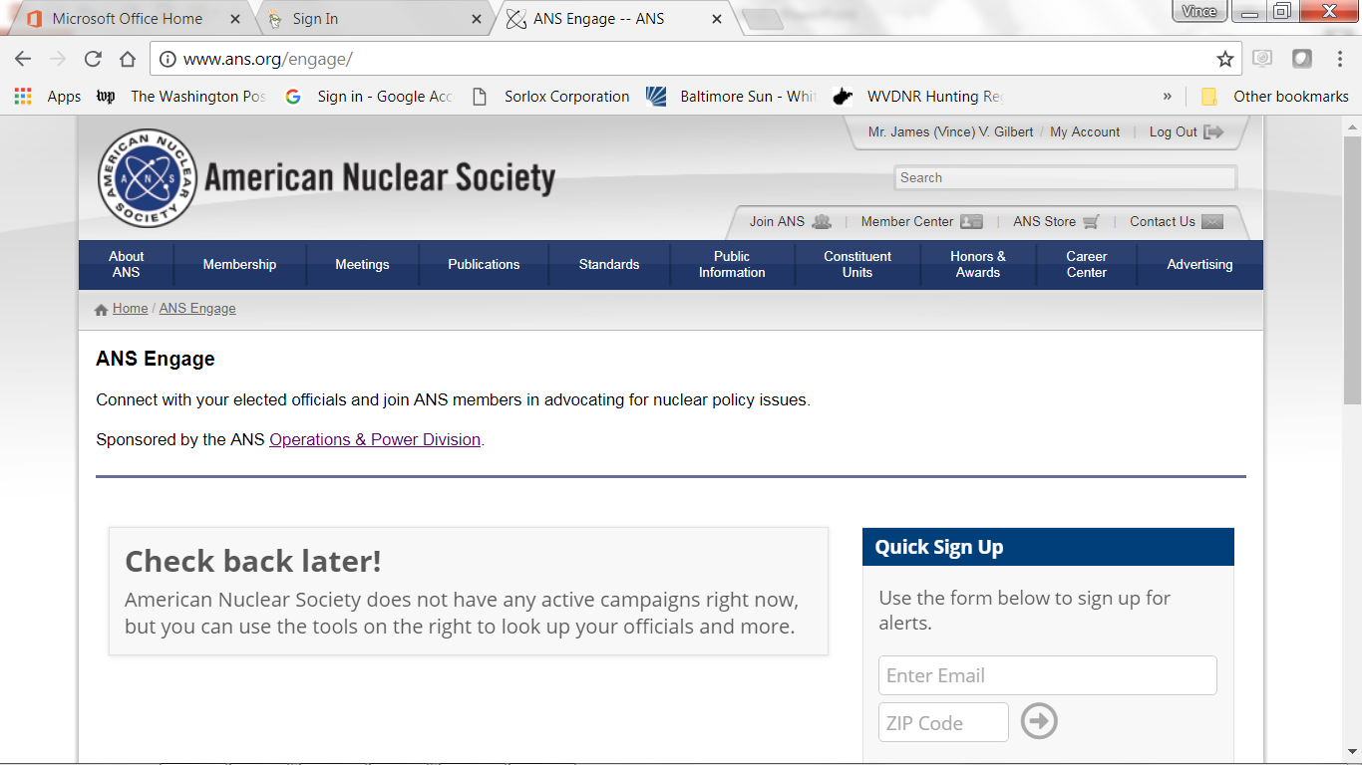
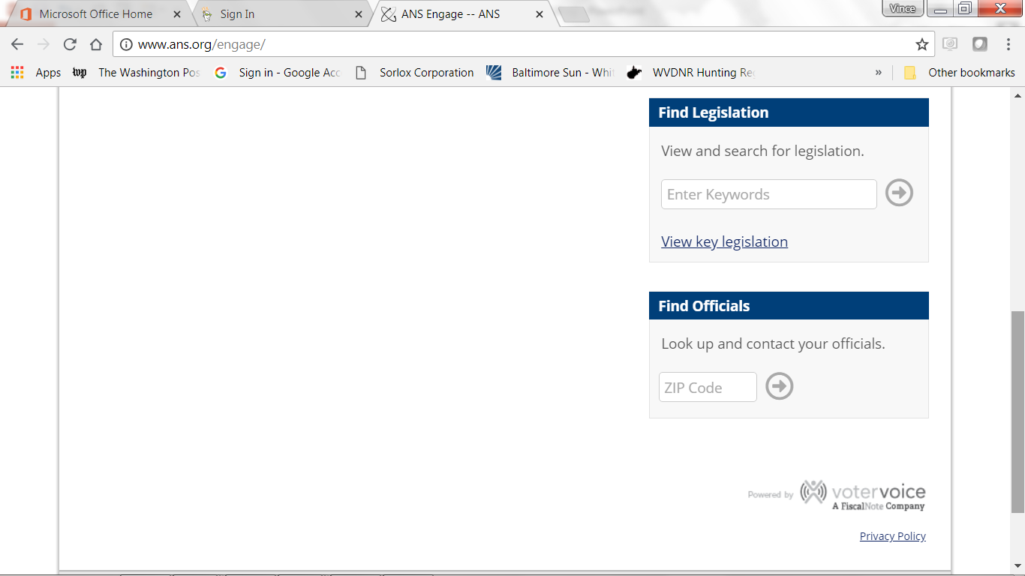
New ANS Washington, DC Office Tool
http://www.ans.org/engage/
Sponsored by OPD !

Slide 16
Evaluation of Pilot Program
OPD EC is evaluating Pilot Program results and may adjust process to make improvements
Funding levels
Process Method Streamlining
Composition of the Review Committee
Strength of Local Sections
Inclusion of other ANS Divisions

Slide 17
Program Changes being Considered June-Dec 2018
Increase budget for grants in 2019
Revise process form as follows:
Add the place for a tracking number (2019-01, etc.)
Add a place to state the TITLE of the Requested Grant
Clarify what money is being requested by calendar year as well as specifying the total 2018, 2019 etc.
Specify the ANS LOCAL SECTION NAME sponsoring the proposal

Slide 18
Program Changes being Considered June-Dec 2018
3. Other changes
Consider a Bylaw change naming a specific officer to Chair the Review Committee (such as the Past Chair, if change is required) or otherwise formalize the NIMBY Grant Review Committee.
Consider allowing OPD Division Past Chairs and other Outside OPD Division Past Chairs to serve on the review committee
Change Reviewer signatures to a Chair Statement listing names of the reviewers and project owners. (reduce signatures)
Recommend an ANS –wide new strategic task to strengthen ANS Local Sections

Slide 19
Specific Recommendations
Other improvements to the process
4. Investigate improvements that can be made to the Disbursing Form process (timeliness and notifications to requestor)
5. Conduct an assessment of the strength of ANS Local Sections
6. Identify opportunities for adding ANS Local Sections in places that would better support nuclear utilities
7. Encourage participation of other ANS Divisions in the grant program.

